Slide 1
Java OOP
Introduction to object oriented programming Objects and classes
Constructors this keyword Access Modifiers
Method Overloading
String representation of an object

Slide 2
OOP Concepts : Knowledge Check
What are the different principle of OOPS?
Different principles of OOPS are Abstraction, Encapsulation, Polymorphism
and Inheritance.
Abstraction:– It is a thought process which show only the necessary properties.
Encapsulation:– Hiding complexity of a class.
Inheritance:- Defining a Parent-Child Relationship.
Polymorphism:– Object Changes it’s behaviour according to the situation.

Slide 3
Structure of a Java class
[package packagename; ]
import packagename.classname;
……
public class ClassName [extends SuperClassName [ implements InterfaceName,… ] ]
{
instance variables (instance fields) class variables (static fields)
Can be public or package-private(default)
constructor methods getter and setter methods business-logic methods
}
Note: Methods are of two types:
Instance methods
Static methods
3

Slide 4
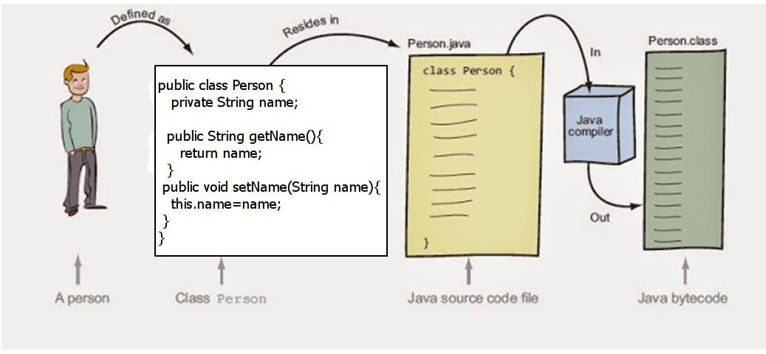
Java Class Example
To test Person class, Create a Tester class ( a class that contains main() method. Ex. PersonTester)
Instantiate Person class within the main method of Tester
class
Compile PersonTester class
Javac PersonTester.java
Run Java Tester class : java PersonTest
Compiling a Java class
javac Person.java
Instantiating Person class
Person person = new Person();

Slide 5
CONSTITUENTS OF A CLASS
Data members/fields
instance fields/variables
static fields (also called as class variables)
Methods
instance methods
class/static methods
Note : The main method may or may not be present depending on whether the class is a starter/tester class or not.

Slide 6
Instance variables
Instance variables are declared in a class, but outside a method, constructor or any block.
Instance variables are part of an object that occupies memory in the heap when it is created with the use of the keyword 'new' and destroyed by garbage collector when the object has no reference.
Access modifiers can be applied for instance variables.
The instance variables are visible for all methods, constructors and block in the class. Normally, it is recommended to make these variables private (access level)
Instance variables have default values. For numbers the default value is 0, for booleans it is
false and for object references it is null.

Slide 7
Accessing Instance Variables and Methods:
Instance variables can be accessed directly by calling the variable name inside the class. However within static methods and in a different class ( when instance variables are given accessibility) should be called using the fully qualified name objectName.variableName.
ObjectName is also called as ObjectReference.
Instance variables and methods are accessed via created objects.
To access an instance member, the fully qualified path should be as follows:
Ex.
Circle circle = new Circle();
double area;
a = circle.areaOfCircle();
/* First create an object */
ClassName objectReference = new ClassName();
/* Now call a variable as follows */ objectReference.variableName;

Slide 8
this keyword
class Counter{
private int count; // instance variable
public void increment(){
count= count + 1;
}
public int getCount(){
return count;
}
}
class CounterTest{
public static void main(String args[]){ Counter a = new Counter(); Counter b = new Counter(); a.increment();
b.increment(); System.out.println(a.getCount()); System.out.println(b.getCount());
}
}
In the Counter example, when we invoke a.increment(), it contains count=count+1 statement.
Whose count is it?
When we say a.increment() , how does the method know that it has to increment the instance field of object a ?

Slide 9
this keyword
The answer is:
The invoking object is implicitly received within the instance method via this reference.
this is a built-in reference to the invoking object within the instance method
public void increment(){
this.count = this.count + 1;
}
public int getCount(){
return this.count;
}

Slide 10
Java OOP
Constructor methods
default constructor
static/class Variables & Methods
Static block

Slide 11
CONSTRUCTOR METHOD
A constructor method is an instance method that is invoked during the creation of the object.
Memory allocation of objects will be in the heap area
Constructor Methods are primarily used to initialize the data members of an object.
When writing a constructor, remember that:
it has the same name as the class name
it does not return a value not even void.
It may or may not have parameters (arguments) i.e. constructor methods can be
overloaded.
By default, a class is provided with a default constructor( no-arg constructor).

Slide 12
Default Constructor Method
The default constructor provided by java has empty body but the we can explicitly define the default constructor method and initialize data members.
public class Student{
private int admissionCode; private String studentName; private int marks;
//default constructor method
public Student(){
this.admissionCode=1;
this. studentName="Unknown"; this.marks=0;
}
// getter & setter methods
}
Syntax of default constructor:
[access_modifier] classname(){
//code
}

Slide 13
static variable
static variable or class variable
It is a variable which belongs to the class
A single copy is shared by all instances of the class
static variables are placed in method area
static variables can be accessed without creating of instance of the class to which it belongs to
Syntax:
ClassName.staticVariable

Slide 14
static method
static method or class method
Accessed using ClassName.methodName
For using static methods, creation of instance is not necessary
A static method can directly access the static members of the class. Instance members of the
class cannot be directly accessed since static method do not have access to this reference.
To access instance members of the class within the static method , we can achieve indirectly
i.e. by creating instance/object of the class and invoking instance members through the object.
Note: static methods can be accessed with an object reference:
objectName.staticMethodName(args) but this is discouraged because it does not make it clear that they are class methods.

Slide 15
static data member : DEMO
Class Duck { private int size;
private static int duckCount;
public Duck(){
duckCount++;
}
public void setSize (int size){
this.size = size;
}
public int getSize (){
return this.size;
}
public static void main(String args[]){
System.out.println(“Size of the duck is;” + size);
Duck duck1 = new Duck();
System.out.println(duck1.getSize()); // duck1.size
}}
The static duckCount variable is initialized to 0, ONLY when the class is first loaded, NOT each time a new instance is created.
Each time the constructor is invoked ie an object gets created, the static variable duckCount will be incremented thus keeping a count of the total no of Duck objects created
Which duck? Whose size? A static method cannot directly access non-static.

Slide 16
Re-writing the class, Duck
public class DuckDemo {
public static void main(String[] args) { System.out.println("Duck size : "+ size); Duck duck1 = new Duck();
System.out.println("Duck size : "+ duck1.getSize()); System.out.println("Total ducks : "+ Duck.getDuckCount()); Duck duck2 = new Duck();
System.out.println("Duck size : "+ duck2.getSize());
System.out.println("Total ducks : "+ Duck.getDuckCount());
}
}
public class Duck { private int size;
private static int duckCount;
public Duck(){
duckCount++;
}
public int getSize() { return size;
}
public void setSize(int size) { this.size = size;
}
Java Project : DuckProject
Packages:
com.deloitte.trg.service
Class Name : Duck com.deloitte.trg.ui
Class Name: DuckDemo
public static int getDuckCount() { return duckCount;
}
}

Slide 17
Memory Organization for members of a class
object
Pointer to special
Special structure
Pointer to object that is in heap
Pointer to static
variable
Pointer to getSize()
structure
0 10
size
Pointer to setSize() Pointer to
1
getDuckCount()
0
duckCount
Java Stack
Heap Memory
getSize()
setSize()
getDuckCount()
public static void main(String [] args){
Duck object = new Duck(); object.getSize(); object.setSize(10);
Duck.getDuckCount();
object.getSize();
}
Method Area

Slide 18
static block
static block
The static block is a block of statements inside a Java class that will be executed when a class is first loaded and initialized
A class is loaded typically after the JVM starts
A static block helps to initialize the static variables just like constructors help to initialize instance variables.
public class StaticBlockDemo { private static int a;
private static int b
static{
a=100;b=200;
System.out.println("I'm static block");
}
public static void main(String [] args){
System.out.println(a+", "+b);
}
}
class Test{
static {
//Code goes here
}
}

Slide 19
Java OOP
Access modifiers

Slide 20
Controlling Access to Members of a Class
Access level modifiers determine whether other classes can use a particular field or invoke a particular method.
There are two levels of access control:
At the top level—public, or package-private (no explicit modifier).
At the member level—public, private, protected, or package-private (no explicit modifier).
A class may be declared with the modifier public, in which case that class is visible to all classes everywhere.
If a class has no modifier (the default, also known as package-private), it is visible only within its own package (packages are named groups of related classes)

Slide 21
Controlling Access to Members of a Class
At the member level, you can also use the public modifier or no modifier (package- private) just as with top-level classes, and with the same meaning.
For members, there are two additional access modifiers: private and protected.
The private modifier specifies that the member can only be accessed in its own class.
The protected modifier specifies that the member can only be accessed within its own package (as with package-private) and, in addition, by a subclass of its class in another package.

Slide 22
Controlling Access to Members of a Class
Keyword | Applicable To | Who can Access
private | Data members and methods Inner classes | All members within the same Class only
(No keyword, usually we call it default or package-private) | Data members, methods, classes and interfaces | All classes in the same package
protected | Data members and methods | All classes in the same package as well as all its sub classes , even if sub classes reside in a different package
public | Data members, methods, classes and interfaces | Any class

Slide 23
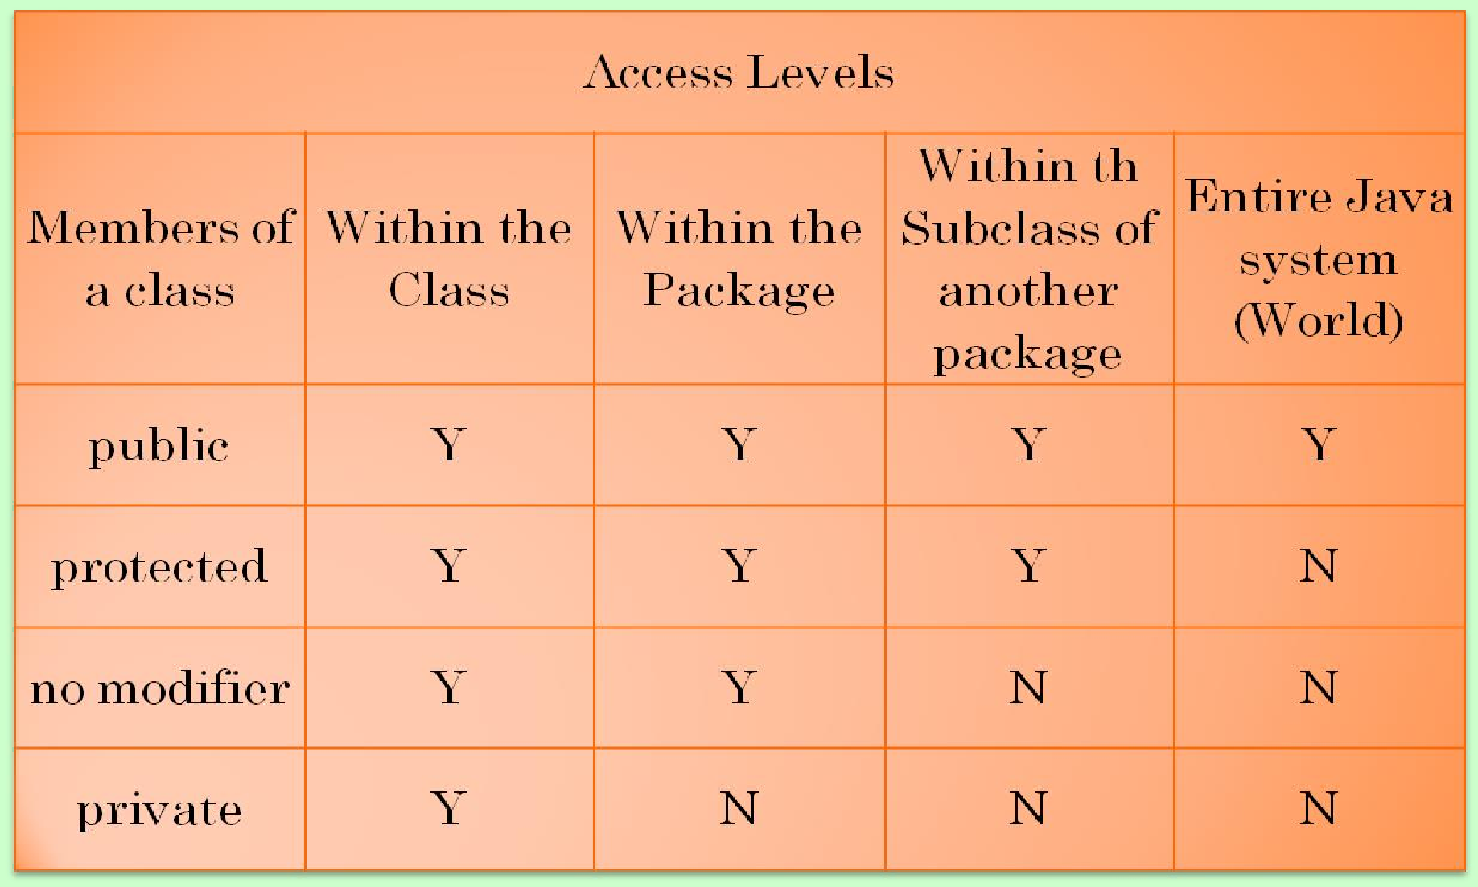
Controlling Access to Members of a Class
The following table shows the access to members permitted by each modifier.

Slide 24
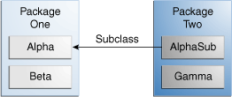

Controlling Access to Members of a Class
Visibility
Modifiers for the members of Alpha class | Alpha | Beta | AlphaSub | Gamma
public
protected
no modifier
private

Slide 25
GENERALIZATION
In the spirit of encapsulation ,
Data members are always kept private
It is accessible only within the class
The methods which expose the behavior of the object are kept
public
However, we can have helper methods which are private
Key features of object oriented programs
encapsulation (binding of code and data together)
State (data) is hidden and Behavior (methods) is exposed to external world

Slide 26
Java - OOP
Variables Scope & Lifetime Object State
Object Reference
Call by value & Call by reference

Slide 27
Variables scope & Lifetime
Java comes with three kinds of scope and we name variables according to the scope they reside in as detailed in the table below.
Variable | Scope | Lifetime
static | Static variables apply to the class as a whole and are declared within the class but outside a method. | Exists for as long as the class it belongs to is loaded in the JVM.
instance | Instance variables apply to an instance of the class and are declared within the class but outside a method. | Exists for as long as the instance of the class it belongs to.
local | Local variables apply to the method they appear in. | Exists until the method it is declared in finishes executing.

Slide 28
Object State
Each time we create a new instance of the class, that instance gets its own set of instance variables. The values held within each instance are known as object state.
Objects live on the Heap and so does the instance variables which represents an Object State.

Slide 29
Object Reference
What is Object Reference variable in java?
Simply, it is a variable whose type is an object type; i.e. some type that is either java.lang.Object or a subtype of java.lang.Object.

Slide 30
Object Reference
You can not do pointer arithmetic with references.
References are strongly typed. Another difference is that the type of a reference is much more strictly controlled in Java than the type of a pointer is in C.
In C you can have an int* and cast it to a char* and just re-interpret the memory at that location.
That re-interpretation doesn't work in Java: you can only interpret the object at the other end of the reference as something that it already is (i.e. you can cast a Object reference to String reference only if the object pointed to is actually a String).
Object object1="Hello";
String string1=(String) object1;
System.out.println(string1);
Runtime exception java.lang.ClassCastException: java.lang.Integer cannot be cast java.lang.String
to
Object object2=100;
String string2=(String) object2;
System.out.println(string1);
Integer intObject = (Integer) object2;//Valid
System.out.println(intObject);

Slide 31
Call by value & Call by reference
Some Definitions
Call by value: pass contents of the actual parameter.
Call by reference: pass address of the actual parameter.
Java is always call-by-value. Primitive data types and object reference are just values.
Passing Primitive Type Variable
Since Java is pass-by-value, it's not hard to understand the following code will not swap
anything.
public void swap(Type arg1, Type arg2) { Type temp = arg1;
arg1 = arg2; arg2 = temp;
}

Slide 32
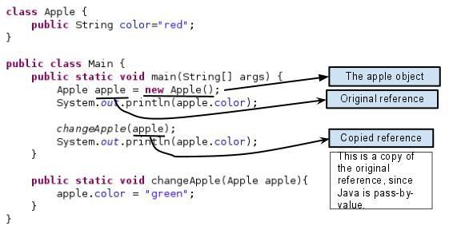
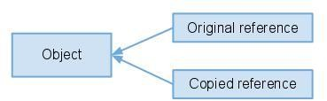
Passing object reference
What is the output ?
Since the original and copied reference refer the same object, the member value gets changed.
Output : red green

Slide 33
Java-OOP
Constructor overloading
this() method

Slide 34
CONSTRUCTOR OVERLOADING
Defining more than one constructor method within a class is called as constructor overloading.
The constructor methods defined in a class should differ in number of arguments or their types.
Since the constructor methods receive parameters, they are also called as
parameterized constructor methods.
Recall that default constructor does not receive any parameters and also remember that constructor methods are instance methods that get implicitly executed during the creation of objects.

Slide 35
CONSTRUCTOR OVERLOADING Example
public class Circle {
private int x,y;
private double radius;
public Circle() {
x = 0; y = 0; radius = 0.0;
}
public Circle(int x, int y, double radius) { this.x = x; this.y = y;
this.radius = radius;
}
public Circle(double radius) {
this.x = 0;
this.y = 0; this.radius = radius;
}
public Circle(Circle circle) { this.x = circle.x;
this.y = circle.y;
this.radius = circle.radius;
}
Circle obj1= new Circle();
Circle obj2= new Circle(10,20,5.4); Circle obj3= new Circle(5.4);
Circle obj4 = new Circle(obj2);

Slide 36
this() method
Purpose:
To invoke one constructor method within another constructor method of a same class.
Usage:
To avoid duplication of code within parameterized constructors of a class.
Note: this() method can be called only within the constructor method and it has to be the
first statement of the constructor method.

Slide 37
Constructor Overloading Example Re-written
public class Circle {
private int x,y;
private double radius;
public Circle(int x, int y, double radius) { this.x=x;
this.y=y;
this.radius = radius;
}
public Circle() {
this(0,0,0);
}
public Circle(double radius) {
this(0,0,radius);
}
public Circle(Circle circle) { this(circle.x, circle.y, circle.radius);
}
}
Circle obj1= new Circle();
Circle obj2= new Circle(10,20,5.4); Circle obj3= new Circle(5.4);
Circle obj4 = new Circle(obj2);

Slide 38
Java - OOP
Method Overloading final variable

Slide 39
METHOD OVERLOADING
Defining more than one method within a class having same name but differing in method signature are termed overloaded methods
The method signature refers only to parameter-list
Calls to overloaded methods will be resolved during compile time
Also known as static polymorphism or static binding
Argument(Parameter) list could differ via:
Number of parameters
Datatype of parameters
Sequence of parameters
If two or more method have same name and same parameter list but differs in return type are not said to be overloaded method
Access modifiers are also not part of method signature

Slide 40
METHOD OVERLOADING
Ex.
Overloaded methods
void add (int a, int b)
int add (int a, float b)
void add (int a, float b)
void add (int a, int b, float c)
Not overloading. Compiler error.
int add (int a, float b)
void add (int a, float b)

Slide 41
METHOD OVERLOADING Example
public class MethodOverload { void test(int a) { System.out.println("a: "+a);
}
void test(int a,int b) {
System.out.println("a and b: "+ a+","+ b);
}
void test(float a) {
System.out.println("double a: "+a);
}
}
public class MethodOverloadTest {
public static void main(String[] args) {
MethodOverload overload=new
MethodOverload();
overload.test(10);
overload.test(10,2);
//overload.test(5.5); overload.test((float) 5.5);
Output: a:10
a and b:10,20 double a:5.5
}
}

Slide 42
METHOD OVERLOADING : implicit data conversion example
class Overload {
void test(int a, int b) {
System.out.println("a and b: " + a + "," + b);
}
void test(double a) {
System.out.println("double a: " + a);
}
}
class MethodOverloading {
public static void main(String args[]) {
Overload overload = new Overload();
overload.test(10); overload.test(10, 20); overload.test(5.5);
}
}
Output:
double a:10.0 a and b:10,20 double a:5.5
Implicit data conversion takes place. int is converted to double

Slide 43
METHOD OVERLOADING
class Overload { void test(int a) {
System.out.println("a: " + a);
}
void test(int a, int b) {
System.out.println("a and b: " + a + "," + b);
}
class MethodOverloading {
}
public static void main(String args[]) {
Overload overload = new Overload();
overload.test(10); overload.test(10, 20);
Solution:
overload.test((int)5.5);
overload.test(5.5);
COMPILATION
ERROR
}
}

Slide 44
final variables
final is a keyword in java and can be applied to member variables, methods, classes and local variables in Java.
What is final variable in Java?
Any variable either member variable or local variable (declared inside method or block) modified by final keyword is called final variable.
final variables are often declared with static keyword in java and treated as constants.
Note: Final variables are equivalent to constants in other programming languages. So they have to be initialized during declaration & cannot be modified later.

Slide 45
final variables
public class FinalVariableExample { public static void main(String[] args) {
//final int HOURS_IN_DAY=24;
final int HOURS_IN_DAY;
//Valid: One time assignment is allowed HOURS_IN_DAY=24;
//Compile Error: Cannot assign again
//HOURS_IN_DAY=12;
Compilation error
public static final int HOURS_IN_DAY; Conversion specifiers and static keyword cannot be applied for local variables.
System.out.println("Hours in 5 days = "+ HOURS_IN_DAY*5);
}
}
Note: The names of variables declared class constants and of ANSI constants should be all uppercase with words separated by underscores ("_").

Slide 46
Java - OOP
String representation of an object

Slide 47
String representation of an object
The toString() method of an Object class returns a string representation of the object.
In general, the toString method returns a string that "textually represents" this object.
We can override the toString() method of Object class to provide string representation of the object.
Except for wrapper class objects and String objects, when an object is placed in println() method, following is displayed:
packagename.classname@ unsigned hexadecimal representation of the hash code of the object.
In other words, this method returns a string equal to the value of:
getClass().getName() + '@' + Integer.toHexString(hashCode())

Slide 48
String Representation of an object
public class Demo {
private String message;
public Demo(){ this.message="Hi! Welcome";
}
public String getMessage() { return message;
}
public void setMessage(String message) {
this.message = message;
}
@Override
public String toString() {
return "Demo [message=" + message + "]";
}
public class DemoTester {
public static void main(String[] args) { Demo demo = new Demo(); System.out.println(demo);
}
}
If a method marked with @Override fails to correctly override a method in one of its super classes, the compiler generates an error.
}
Demo [message=Hi! Welcome]

Slide 49
Problem-statement : Student class
Create a class, Student in the service layer with the following details :
private Integer admissionCode; private String studentName; private Date birthdate;
private Integer [] marks; // array to hold marks in 3 subjects
private String grade;
private static Integer admissionCounter; private static String schoolName;
Java Project: StudentAdmissionProject
create a static block to store “Hyderabad Public School” in static field schoolName .
default constructor – admissionCode to be auto generated with the help of admissionCounter variable.
2-arg constructor that takes studentName and birthdate as arguments- admissionCode to be auto generated using
admissionCounter variable.
3-arg constructor that takes studentName, birthdate and marks as arguments- admissionCode to be auto generated using admissionCounter variable.
Note: Invoke 2-arg constructor within 3-arg constructor using this() method
Getter for all the data members.
Setter methods for studentName, birthdate and marks
Setter method for grade has to assign grade based on total marks(subject1+subject2+subject3) as follows:
Excellent : if marks between 240 and 300, Good : if marks between 239 and 180,
Average : if marks between 150 and 179 and Fail : if marks are less than 150.
Getter and setter methods for schoolName
Override toString() method to provide String representation of the Student class

Slide 50
Problem-statement : StudentValidator class
The following class to be created in service layer
Class : StudentValidator
An instance method, public boolean isValidStudentName(Student student) returns true if the
student name contains only alphabets and spaces else returns false.
An instance method, public boolean isValidStudentBirthdate(Student student) returns true if
student’s birthdate least greater than current date by 5 years else returns false
An instance method public boolean isValidStudentMarks(int [] marks) that returns true if marks in all the 3 subject are between 0 to 100, else returns false.
An instance method, public boolean isValidStudent(Student student) returns true if the Student object is valid based invoking the above 3 methods int this method else returns false.

Slide 51
Problem-statement : StudentManager class
The following class to be created in service layer
Class : StudentService
A instance method,
A instance method, public void showStudentDetails(Student [] student)
Displays students details along with their school name.

Slide 52
Problem-statement : StudentTester class
Create Tester class, StudentTester in ui layer.
Create at least 5 Student objects, place them in an array .
Note: Before placing the Student object in the array, validate the Student object by
invoking isValidStudent() of StudentValidator class.
Display all the students details, along with their school name by invoking
showStudentDetails() method of StudentManager class.

Slide 53
Thank You!

